Slide 1
Natural Language Processing(NLP)

Slide 2
Outlines
What is NLP?
Input and Output of NLP
NLP Tools
Components of NLP
Broad Classification of NLP
Natural Language Understanding (NLU)
Natural Language Generation (NLG)
Difficulties in NLU
Steps of NLP
Context Free Grammar
Top-Down Parser
Benefits of NLP
Why NLP matters?
How NLP works?
Challenges of NLP
NLP Pipeline
Real World Applications of NLP
Recent Developments in NLP
Conclusion
References

Slide 3
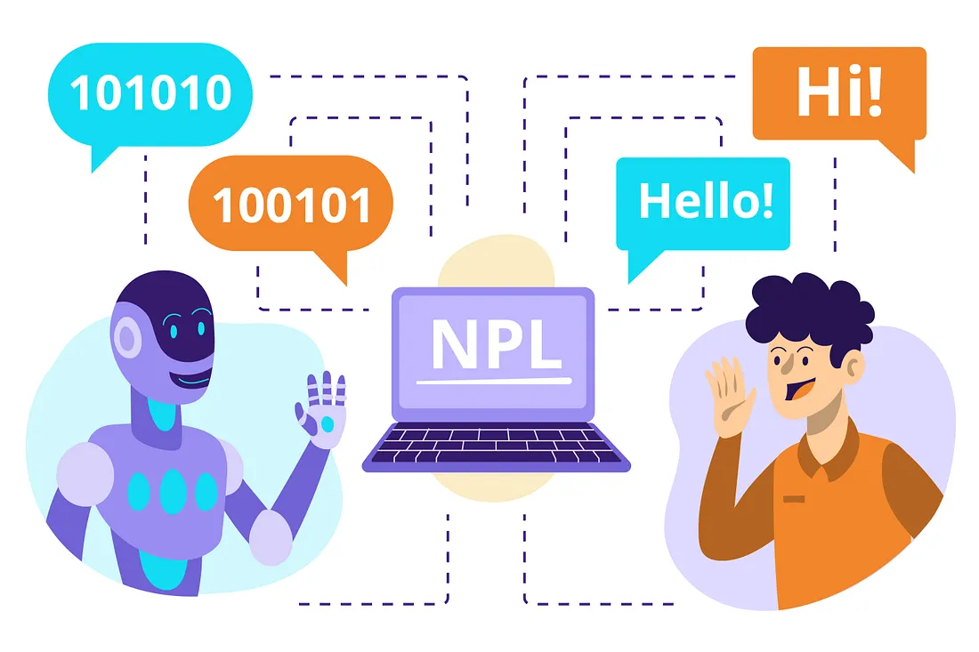
What is NLP?
Ability of a computer program to understand human language as it is spoken and written.
Gives computers the ability to interpret, manipulate, and comprehend human language.
Example: Language translation, Search results, Predictive text.

Slide 4
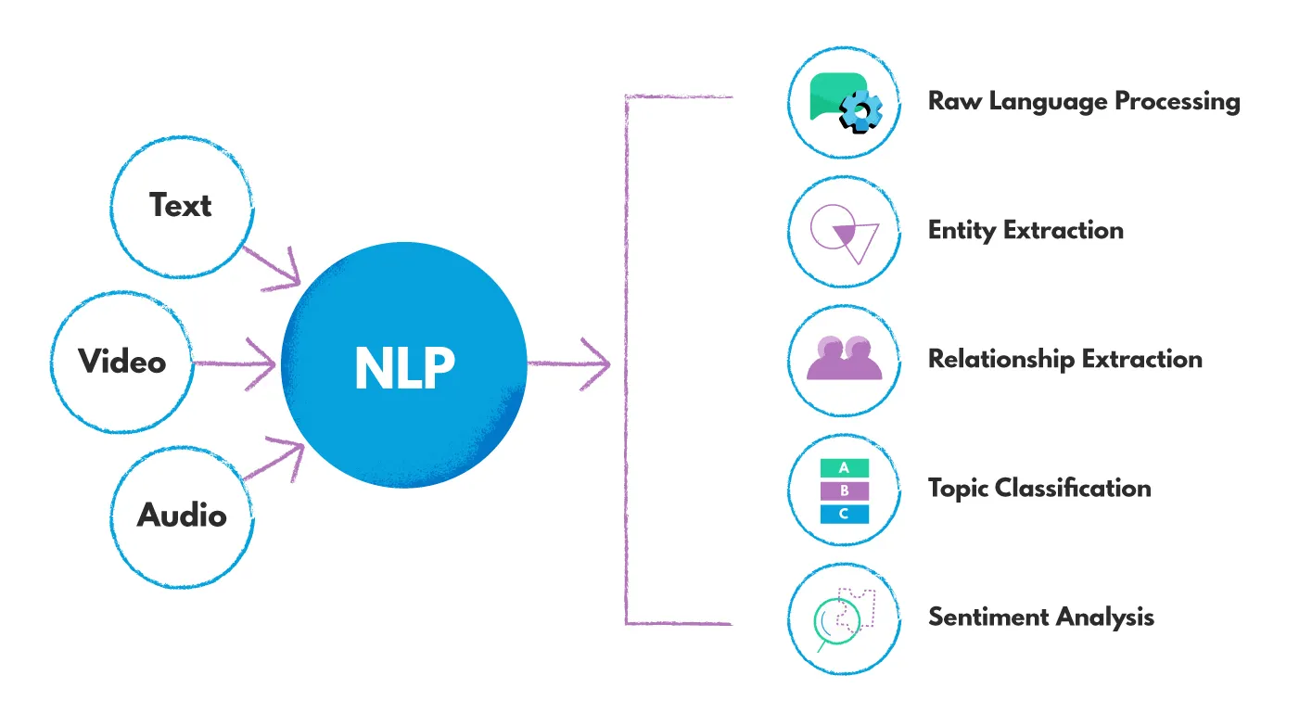
Input and Output of NLP
The input and output of an NLP system can be
Speech
Written Text

Slide 5


NLP Tools:
MonkeyLearn:
platform for text analysis, allowing users to get actionable data from text.
provides instant data visualizations and detailed insights for when customers want to run analysis on their data.
Customers can choose from a selection of ready-machine machine learning models or build and train their own.
OpenAI:
used for NLP tasks such as text classification, sentiment analysis, language translation, text generation, and question answering.

Slide 6
Components of NLP
NATURAL LANGUAGE COMPONENTS
Speaker Generator
Component and Level
of Representation
application or speaker
Textual Organization
Realization
Content Selection
Linguistic Resource

Slide 7
Broad Classification of NLP
NATURAL LANGUAGE Processing
Natural Language Understanding
(Linguistics)
Natural Language Generation
Natural Language Text
Phonology
Syntax
Morphology
Semantics
Pragmatics

Slide 8
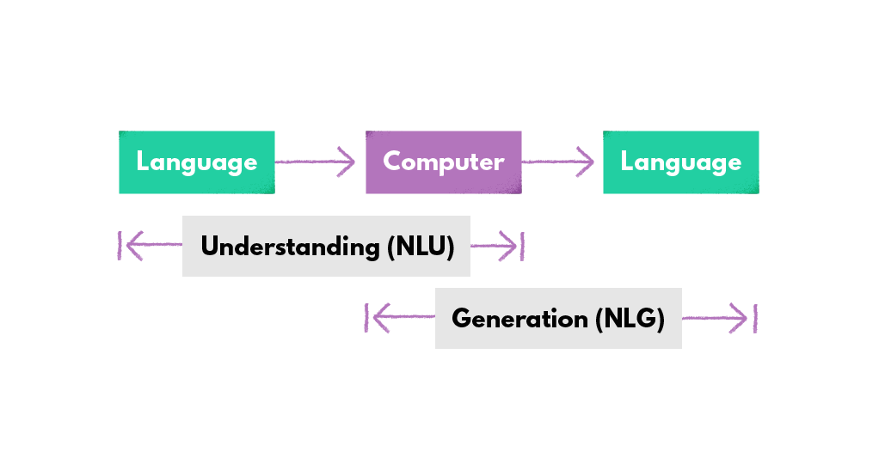
Natural Language Understanding (NLU)
deals with the ability of computers to understand human language
Mapping the given input in natural language into useful representations.
Analyzing different aspects of the language.

Slide 9
Natural Language Generation (NLG)
In many of the most interesting problems in natural language processing, language is the output. Natural language generation focuses on three main scenarios:
It involves –
Text planning − It includes retrieving the relevant content from knowledge base.
Sentence planning − It includes choosing required words, forming meaningful phrases, setting tone of the sentence.
Text Realization − It is mapping sentence plan into sentence structure.

Slide 10
Difficulties in NLU
The NLU is harder than NLG.
NL has an extremely rich form and structure.
Lexical ambiguity − It is at very primitive level such as word-level.
For example: treating the word “board” as noun or verb?
Syntax Level ambiguity − A sentence can be parsed in different ways.
For example: “He lifted the beetle with red cap.” − Did he use cap to lift the beetle
or he lifted a beetle that had red cap?
Referential ambiguity − Referring to something using pronouns. For example, Rima went to Gauri. She said, “I am tired.” − Exactly who is tired?
One input can mean different meanings.
Many inputs can mean the same thing.

Slide 11
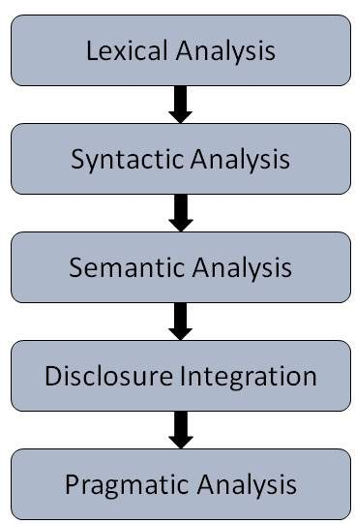
Steps of NLP
Lexical Analysis −
identifying and analyzing the structure of words.
dividing the whole chunk of txt into paragraphs, sentences, and words.
Syntactic Analysis (Parsing) −
analysis of words in the sentence for grammar
arranging words in a manner that shows the relationship among the words.
The sentence such as “The school goes to boy” is rejected by English syntactic analyzer.
CFG and Parsing.
Semantic Analysis −
The text is checked for meaningfulness.
The semantic analyzer disregards sentence such as “hot ice-cream”.
Discourse Integration −
The meaning of any sentence depends upon the meaning of the sentence just before it. In addition, it also brings about the meaning of immediately succeeding sentence.
Pragmatic Analysis −
what was said is re-interpreted on what it actually meant.

Slide 12
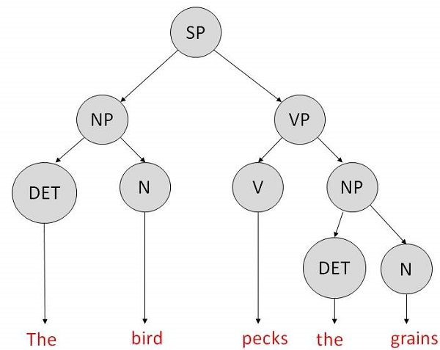
Context-Free Grammar
It is the grammar that consists rules with a single symbol on the left-hand side of the rewrite rules. Let us create grammar to parse a sentence − “The bird pecks the grains”
The rewrite rules or grammer for the sentence are as follows −
S → NP VP
NP → DET N | DET ADJ N
VP → V NP
Lexocon −
DET → a | the
ADJ → beautiful | perching
N → bird | birds | grain | grains
V → peck | pecks | pecking
The parse tree can be created as shown −
The parse tree breaks down the sentence into structured parts so that the computer can easily understand and process it.

Slide 13
Top-Down Parser
the parser starts with the S symbol
attempts to rewrite it into a sequence of terminal symbols that matches the classes of the words in the input sentence until it consists entirely of terminal symbols
checked with the input sentence to see if it matched
If not, the process is started over again with a different set of rules.
repeated until a specific rule is found which describes the structure of the sentence.

Slide 14
Benefits of natural language processing
By enabling computers to understand human language, interacting with computers becomes much more intuitive for humans.
improved accuracy and efficiency of documentation;
ability to automatically make a readable summary of a larger, more complex original text;
useful for personal assistants such as Alexa, by enabling it to understand spoken word;
enables an organization to use chatbots for customer support;
easier to perform sentiment analysis; and
provides advanced insights from analytics that were previously unreachable due to data volume.

Slide 15
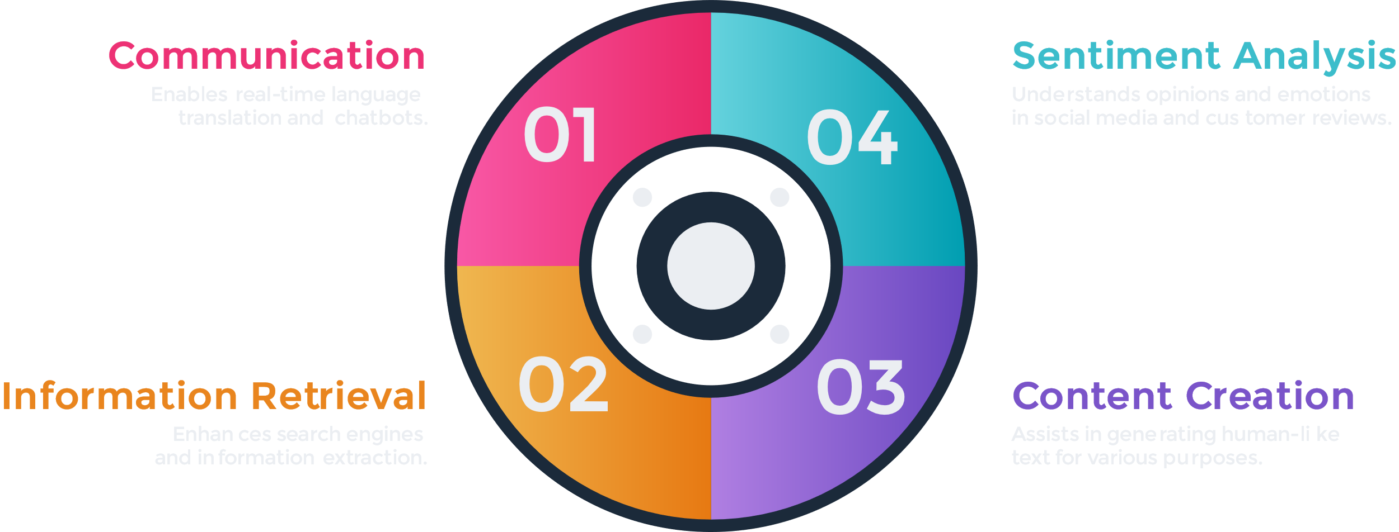
Why NLP matters?

Slide 16
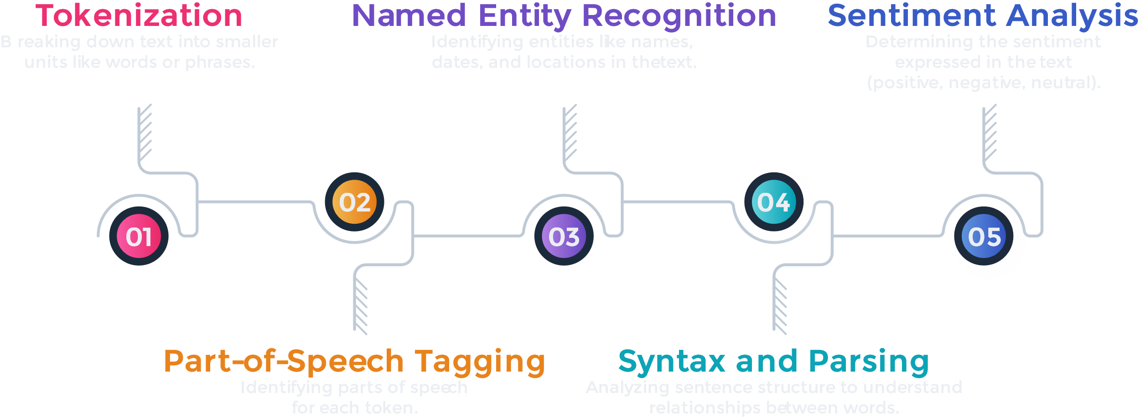
How NLP works?

Slide 17
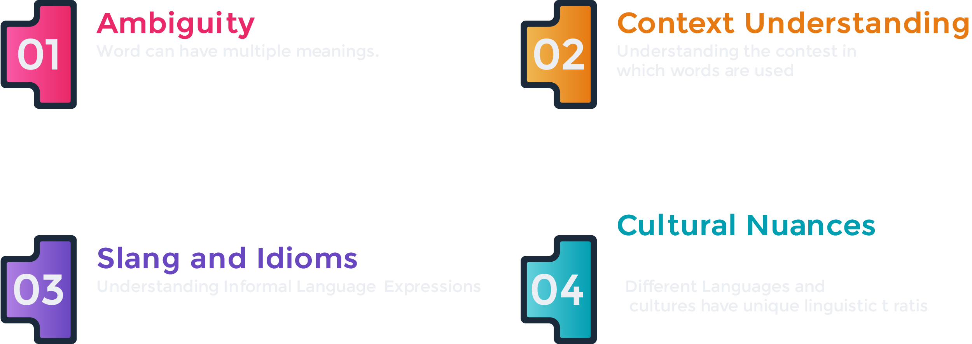
Challenges of NLP

Slide 18
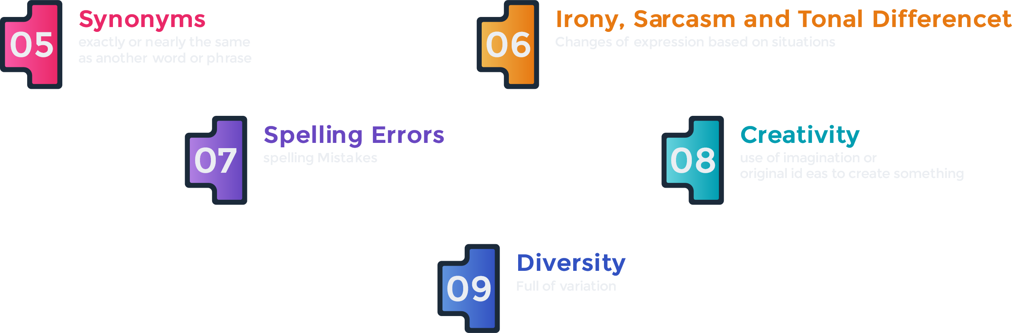
Challenges of NLP

Slide 19
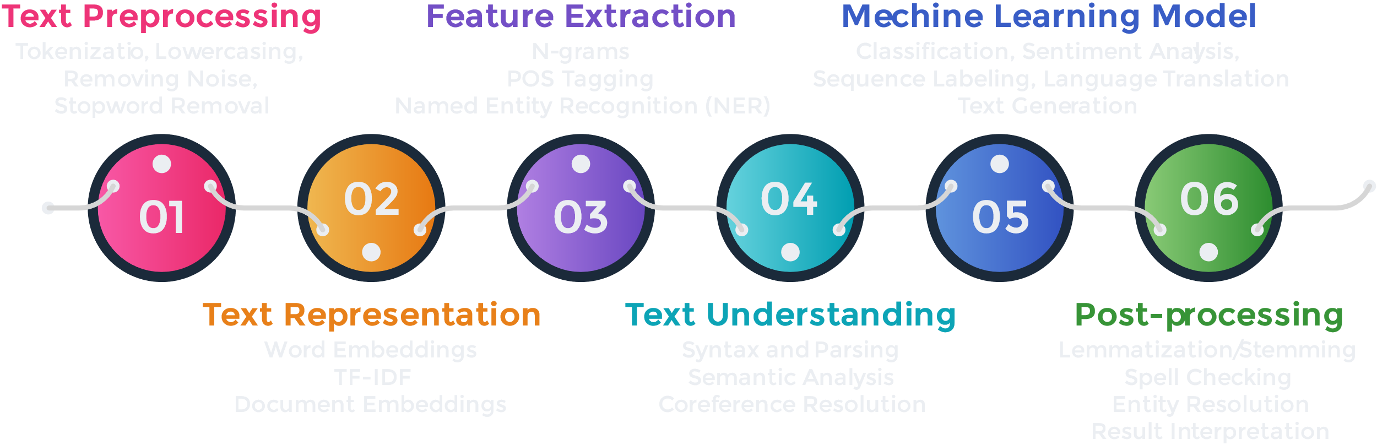
NLP Pipeline

Slide 20
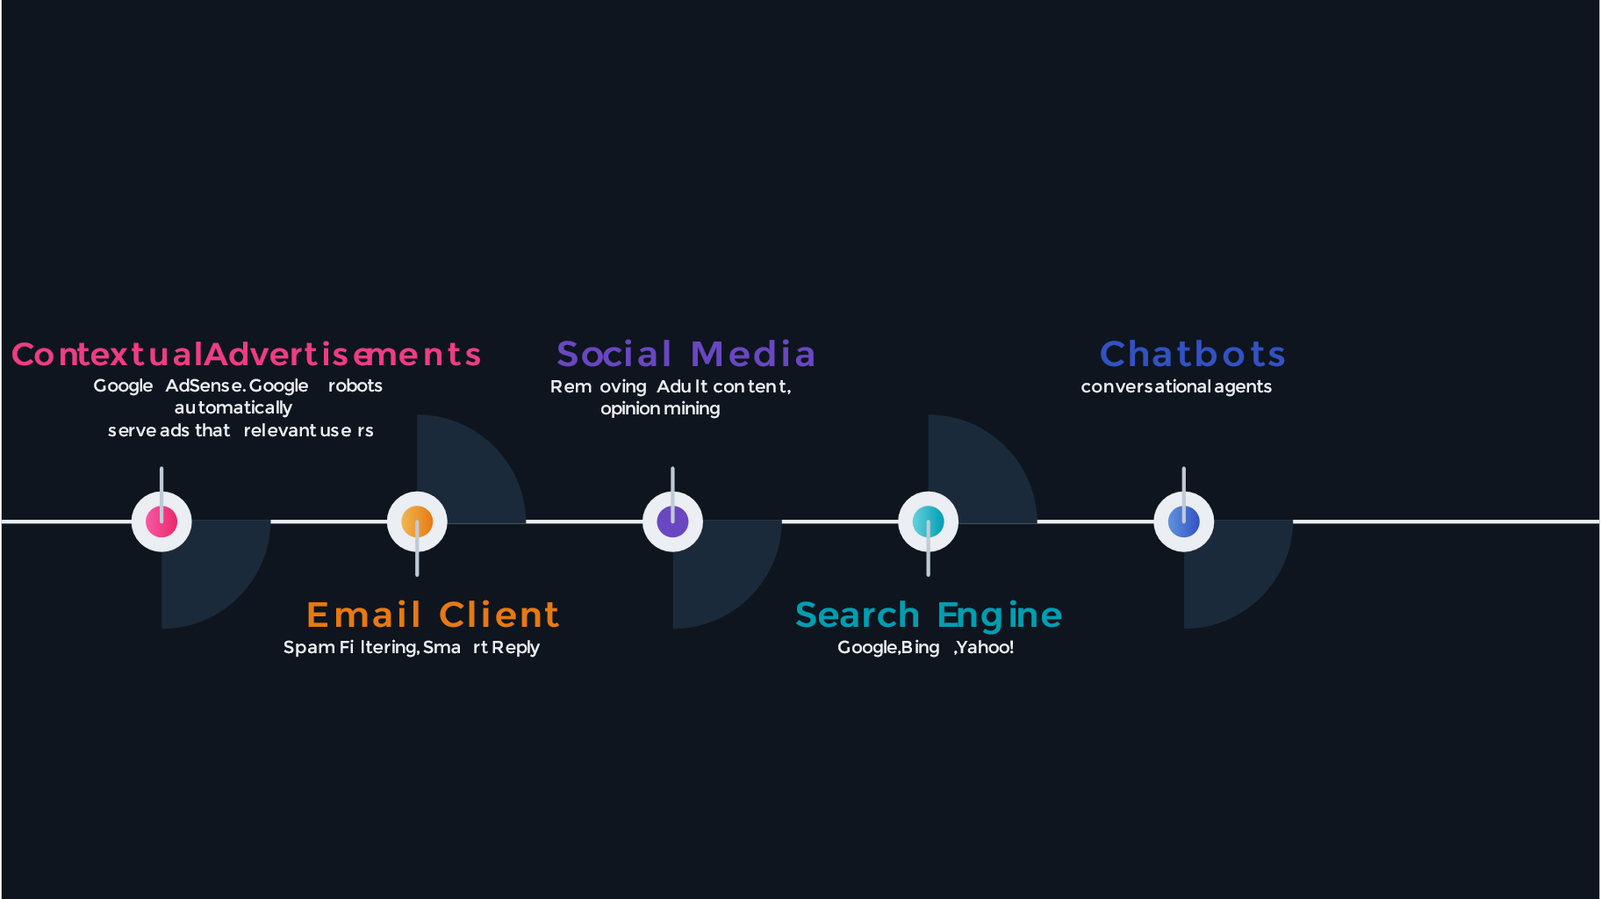
Real World Application

Slide 21
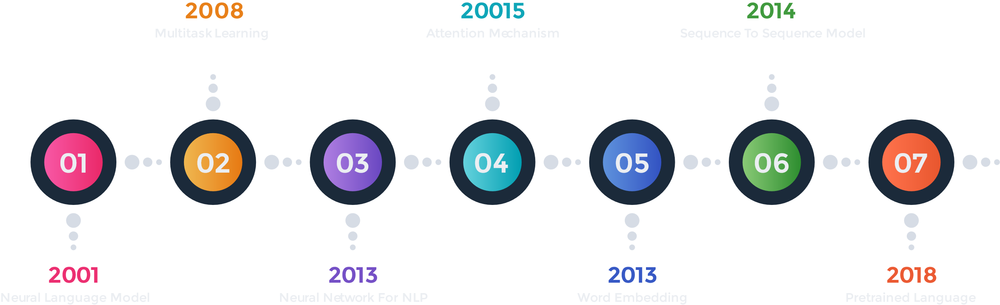
Recent Developments in NLP

Slide 22
Conclusion
In conclusion, Natural Language Processing is revolutionizing the way we interact with technology. Its applications are diverse and its potential is vast. As we move forward, it's crucial to embrace and understand the power of NLP in shaping the future of human-computer interaction. Thank you for your attention! I'm happy to answer any questions you may have.

Slide 23
References:
https://link.springer.com/article/10.1007/s11042-022-13428-4
https://youtube.com/playlist?list=PLKnIA16_RmvZo7fp5kkIth6nRTeQQsjfX&si=IgmSr1Imq37609W1

Slide 24
Thank You!

